Slide 1
Fast Fourier Transform (FFT)
Zach Swanson University of Nebraska – Lincoln ECEN-498 April 16, 2018

Slide 2
Overview
Theory
The Discrete Fourier Transform
Radix-2 FFT algorithms
Real-valued sequences in time
Implementation
Decimation in time
Difficulties
Handling real sequences
Results

Slide 3
FT – DTFT- DFT – FFT What’s the difference?
Fourier Transform
Continuous time => continuous frequency
Discrete Time Fourier Transform
Discrete time => continuous time
Discrete Fourier Transform
Discrete time => discrete frequency
Fast Fourier Transform
Efficient implementations of the DFT

Slide 4
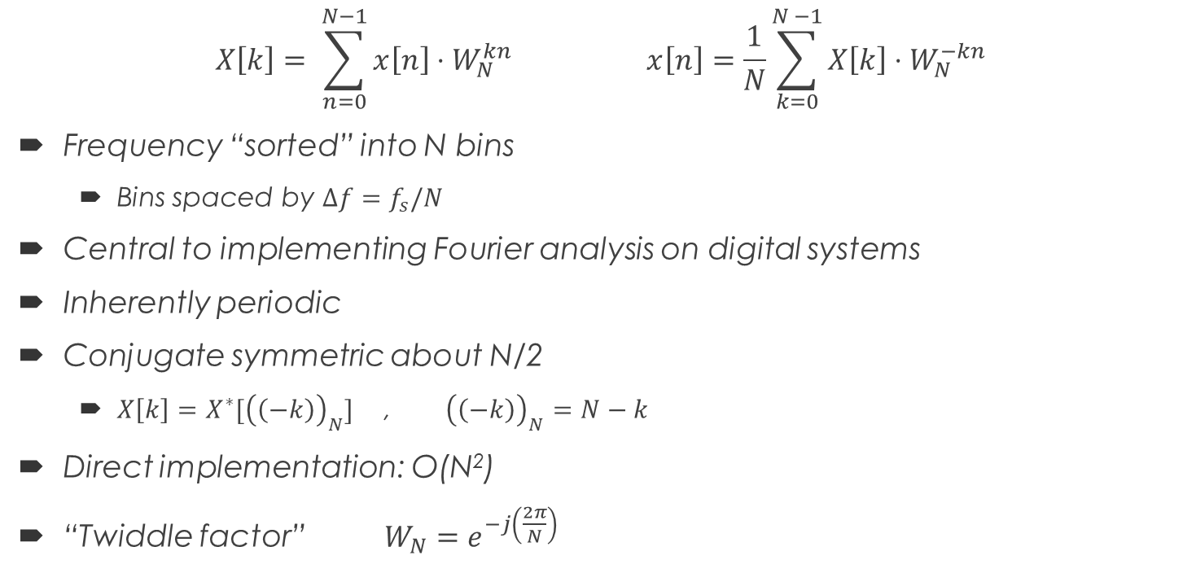
The Discrete Fourier Transform
$$X\left[k\right]= \sum_{n=0}^{N−1}{x\left[n\right]⋅W_{N}^{kn} }x\left[n\right]=\frac{1}{N}\sum_{k=0}^{N −1}{X\left[k\right]⋅W_{N}^{−kn}}$$
Frequency “sorted” into N bins
Bins spaced by $Δf=f_{s}/N$
Central to implementing Fourier analysis on digital systems
Inherently periodic
Conjugate symmetric about N/2
$X\left[k\right]=X^{∗}[{\left(\left(−k\right)\right)}_{N}]$ , ${\left(\left(−k\right)\right)}_{N}=N−k$
Direct implementation: O(N²)
“Twiddle factor” $W_{N}=e^{−j\left(\frac{2π}{N}\right)}$

Slide 5
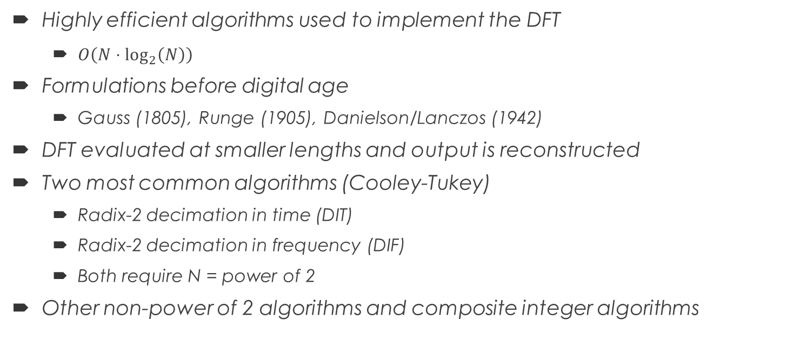
Fast Fourier Transform
Highly efficient algorithms used to implement the DFT
$O\left(N⋅\log_{2}\left(N\right)\right)$
Formulations before digital age
Gauss (1805), Runge (1905), Danielson/Lanczos (1942)
DFT evaluated at smaller lengths and output is reconstructed
Two most common algorithms (Cooley-Tukey)
Radix-2 decimation in time (DIT)
Radix-2 decimation in frequency (DIF)
Both require N = power of 2
Other non-power of 2 algorithms and composite integer algorithms

Slide 6
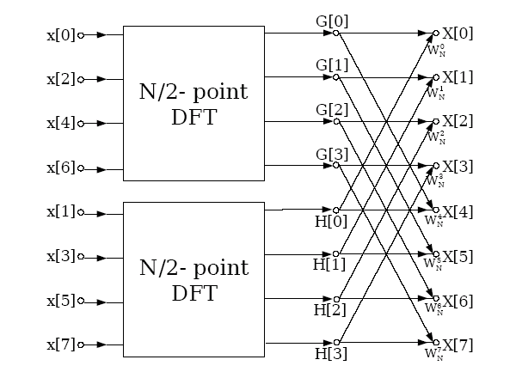
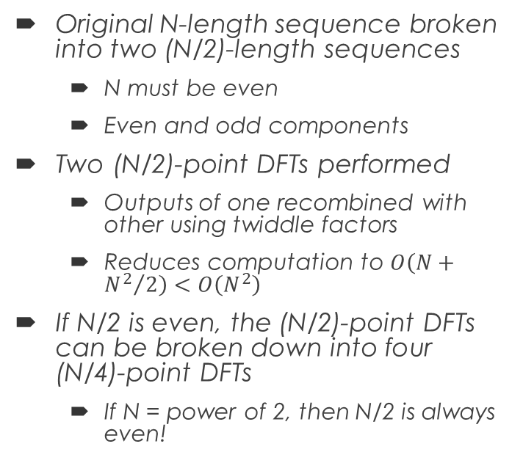
Fast Fourier Transform Radix 2-Decimation in Time
Original N-length sequence broken into two (N/2)-length sequences
N must be even
Even and odd components
Two (N/2)-point DFTs performed
Outputs of one recombined with other using twiddle factors
Reduces computation to $O\left(N+{N^{2}}/2\right)<O\left(N^{2}\right)$
If N/2 is even, the (N/2)-point DFTs can be broken down into four (N/4)-point DFTs
If N = power of 2, then N/2 is always even!

Slide 7
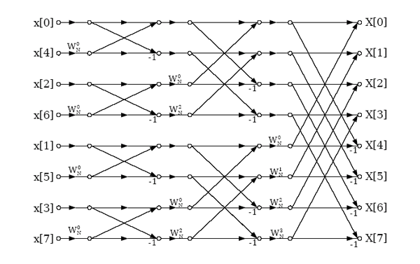
Fast Fourier Transform Radix 2-Decimation in Time

Slide 8



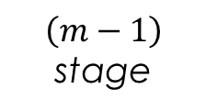
Fast Fourier Transform Radix 2-Decimation in Time
$$\left(m−1\right)$$
stage
$$m$$
stage
$$W_{N}^{r}$$
$$−1$$

Slide 9
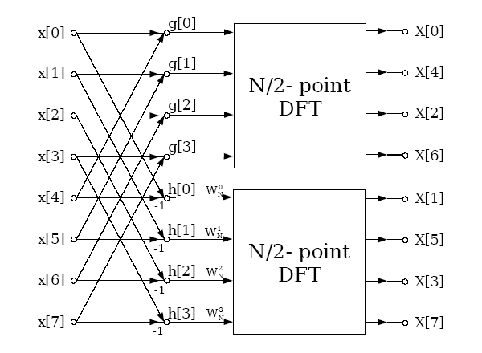
Fast Fourier Transform Radix 2-Decimation in Frequency
Similar to decimation in time
Original sequence divided into smaller (N/2) sequence
Different from sorting into even and odd (N/2) sequences
Subsequences combine using butterflies, and (N/2)-point DFT performed
Output is in bit-reversed order

Slide 10
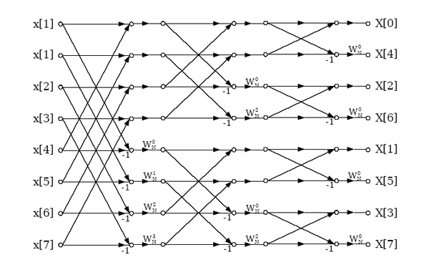
Fast Fourier Transform Radix 2-Decimation in Frequency

Slide 11


Fast Fourier Transform Radix 2-Decimation in Frequency
$$\left(m−1\right)$$
stage
$$m$$
stage
$$−1$$
$$W_{N}^{r}$$

Slide 12
Fast Fourier Transform Real Sequences
The DFT expects complex inputs and generates complex outputs
The vast majority of processed signals are real quantities
Option 1: Zero pad the real signal
{0, 1, 2, … } --> {0, 0, 1, 0, 2, 0, … }
Option 2: Utilize the DFT’s symmetry properties
Compute an N/2 FFT
x[2n] --> real input and x[2n+1] --> imaginary input
Requires unpacking after FFT performed
Only half of the output is provided

Slide 13
Embedded Implementation
In- place decimation in time algorithm
Single complex array (real, complex, real, complex, …)
Q15 number format
Scaling to prevent overflow
Bit-reversing handled in FFT function
Twiddle factor lookup table
Intrinsics used for butterfly computations

Slide 14
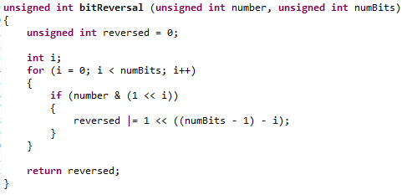
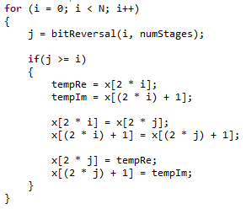
Index Bit Reversal

Slide 15
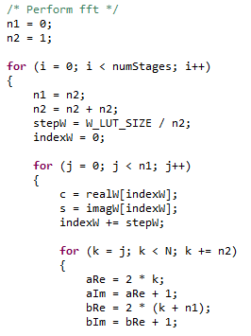
In-Place Computation Indexing

Slide 16
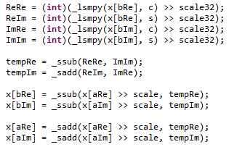
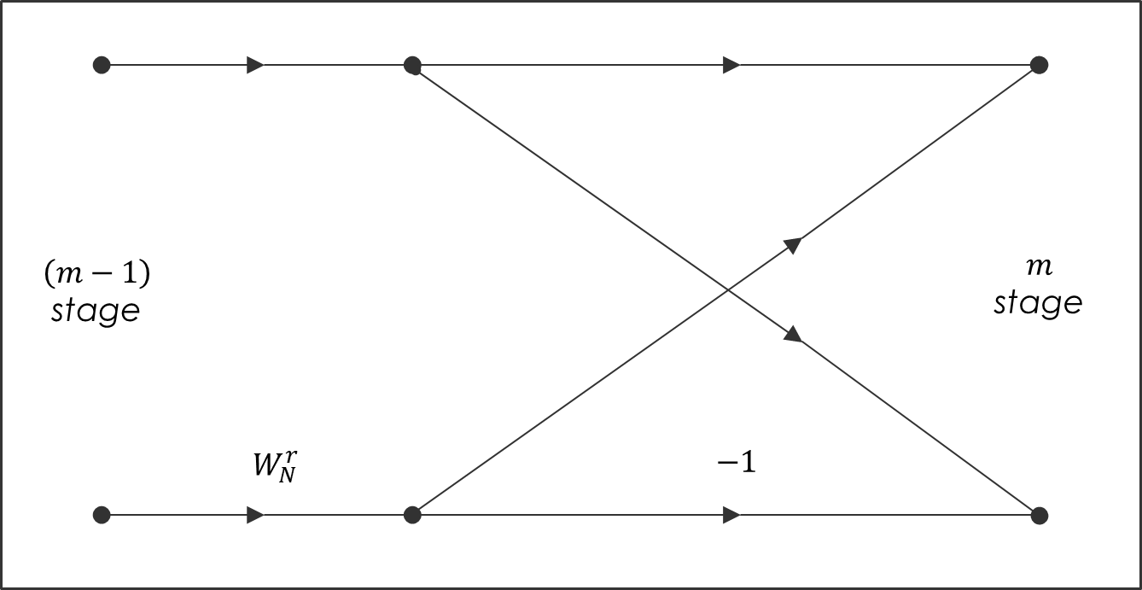
Butterfly Computations

Slide 17
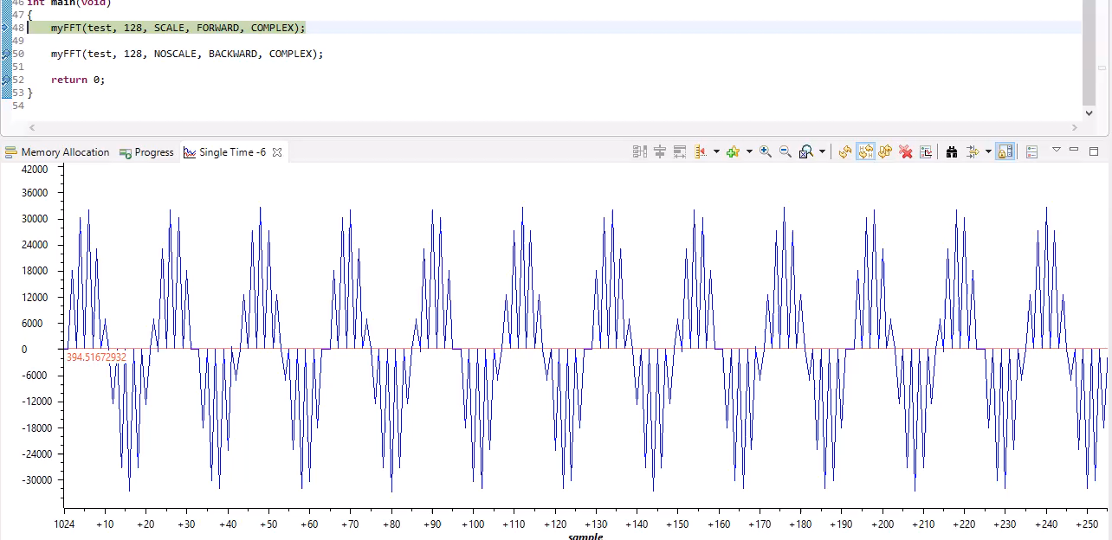
Forward and Backward FFT

Slide 18
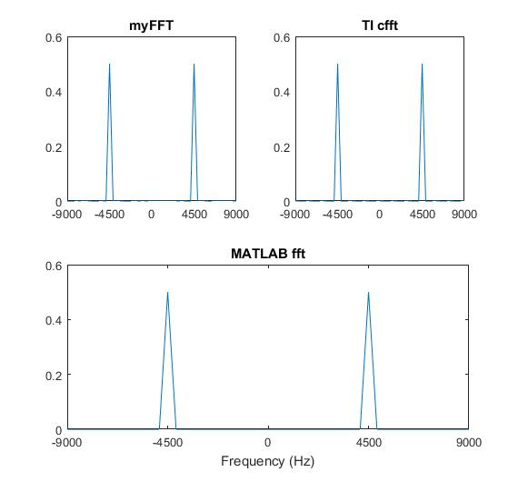
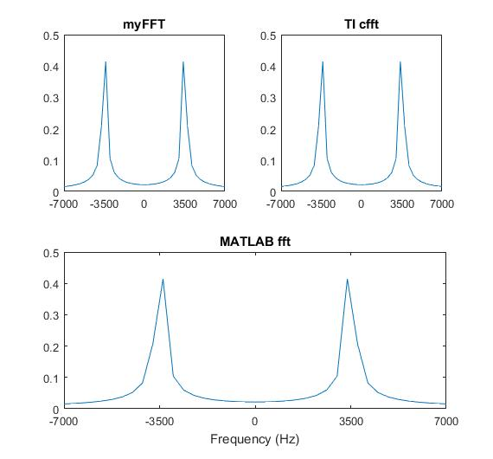
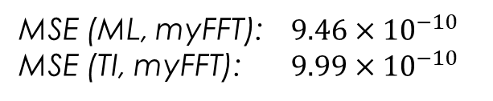
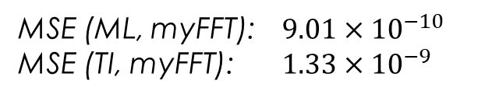
MATLAB and TI Comparison
MSE (ML, myFFT):$9.46×{10}^{−10}$
MSE (TI, myFFT): $9.99×{10}^{−10}$
MSE (ML, myFFT):$9.01×{10}^{−10}$
MSE (TI, myFFT): $1.33×{10}^{−9}$

Slide 19
Cycle Efficiency
All cycle measurements made while performing 128-point fft
TI cfft: 3,101 cycles
TI cbrev: 287 cycles
myFFT: 61,108 cycles
Bit reversal: 21,685 cycles
FFT Calcs: 39,311 cycles
Other: 112 cycles

Slide 20
Further Work
Improve cycle efficiency
Improve bit reversal with a look up table
Consider writing directly in assembly
Implement real-time sequence algorithm
Unable to unpackage (N/2) complex FFT results

Slide 21
References
Oppenheim, A. V., & Schafer, R. W. (2010). Discrete-time signal processing (3rd ed.). Upper Saddle River (N.J.): Prentice-Hall.
Decimation in time. (n.d.). Retrieved April 3, 2018, from https://archive.cnx.org/contents/ce67266a-1851-47e4-8bfc-82eb447212b4@7/decimation-in-frequency-dit-radix-2-fft
Sorensen, H. V., Jones, D. L., Heideman, M. T., & Burrus, C. S. (1987, June). Real-Valued Fast Fourier Transform Algorithms. IEEE Transactions on Acoustics, Speech, and Signal Processing, ASSP-35(6), 849-863.
Jones, K. (2012). Regularized fast hartley transform: Optimal formulation of real-data fast fourier transform .. Place of publication not identified: Springer.

